Slide 1


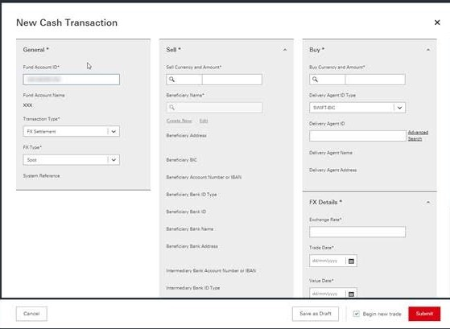
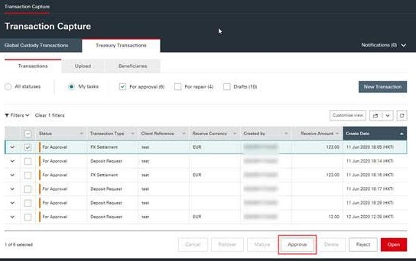
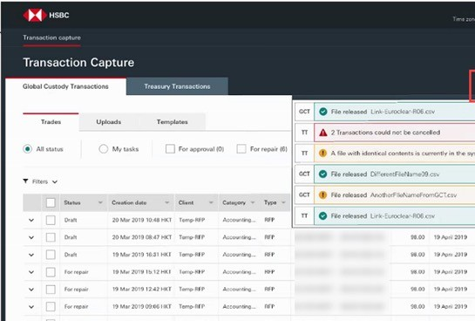
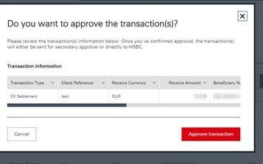
Future State Digital Foreign Exchange Instruction
1
2
FX Instruction entered by client directly into the HSBC Online Trading Portal called HSBCNet
The approver on client side can approve/reject the instruction on HSBCnet before the instructions is routed to HSBC.
Client receives automated email of Trade Settlement or Failure
3
Client may log-in to HSBCNet ad-hoc to check real-time trade status, account balances, download statements, etc. Clients can customize their display and filters and receive notifications.
Examples from the HSBCNet User Guide (masked data)
2 3
1

